Slide 1


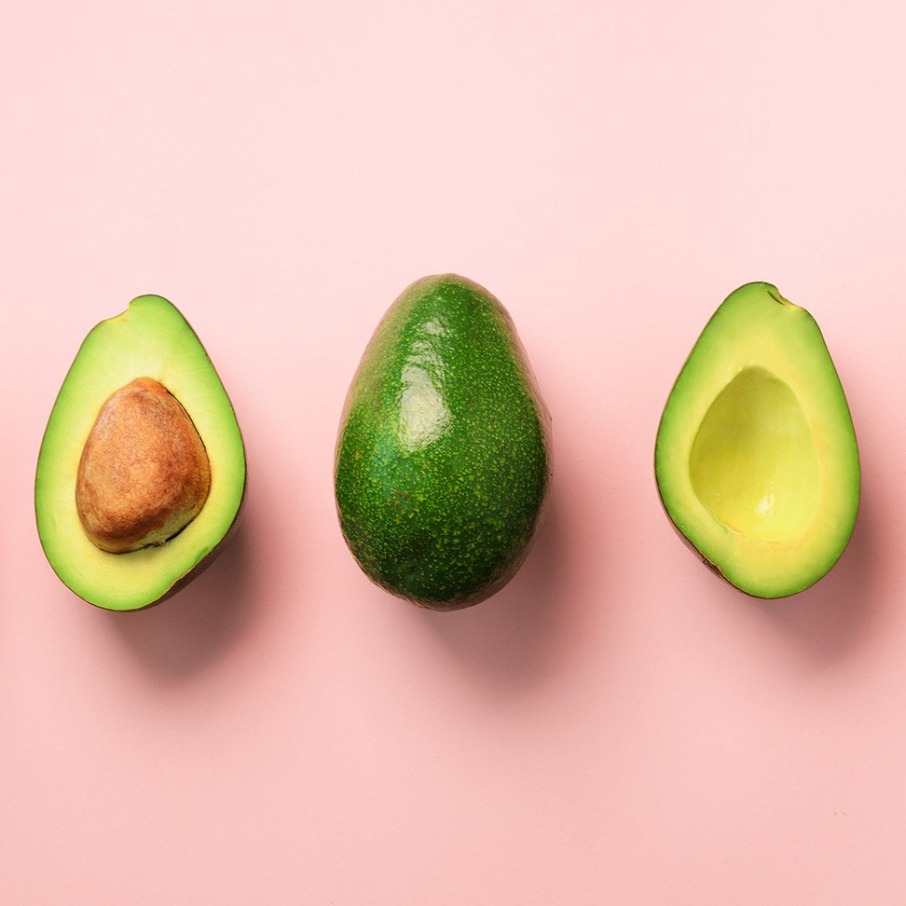


AVOCADOS
Last trends in production worldwide
Natalia Ruiz López - Data Analytics

Slide 2


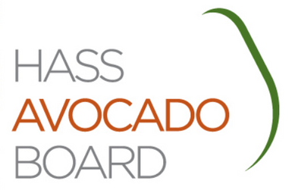
Sources and terminology
Main sources
Hass Avocado Board
FAOSTAT
Terminology
Area Harvested: Hectares used to harvest
Production: Tonnes produced in USD

Slide 3

Objectives
Get to know the overall avocado production in the last 4 years
Find out which countries are the main producers

Slide 4


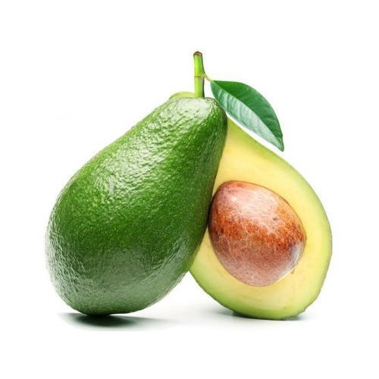
GLOBAL PRODUCTION AND USE OF LAND

Slide 5

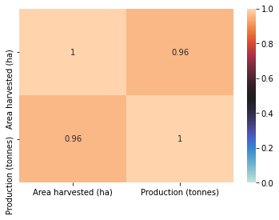
Strong correlation between Area Harvested and Production
Notes:
Firstly I wanted to confirm that it exists a strong correlation between the Area harvested and Production. As you can see on this correlation heatmap, they have a strong correlation. Meaning that the higher the area harvested, the higher the production

Slide 6

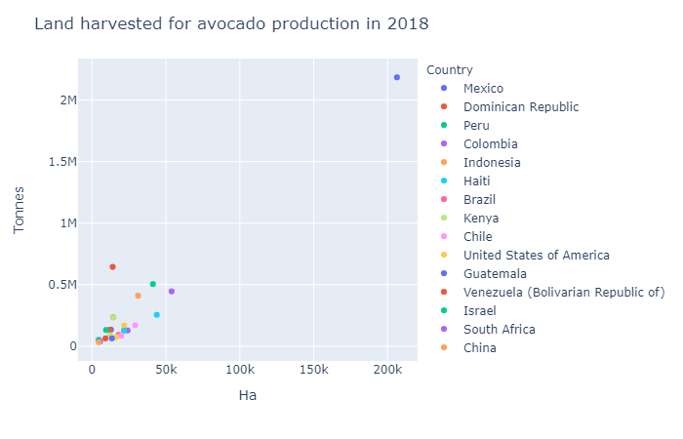
Mexico is the unquestionable front runner
Producing >2M Tonnes in 206K Ha
Other top producers
Dominican Republic, Peru, Colombia, Indonesia, and Haiti are some other remarkable producers

Slide 7
Growth in Production
The production has been increasing over the last years
More countries started to produce avocados (especially in Europe)

Slide 8


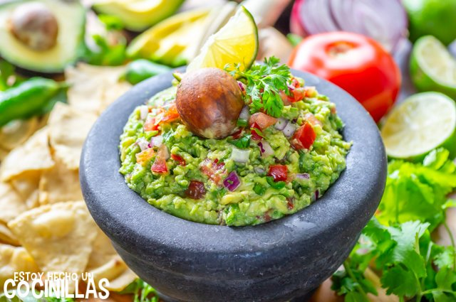
Let's focus now on the top5 avocado producers

Slide 9
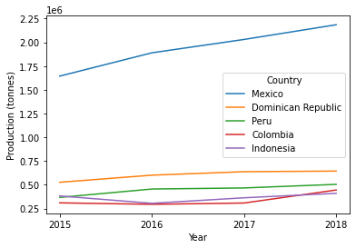
Top 5 countries in avocado production
Mexico's production is on a different scale and constantly growing
The production has increased by 0.6M in 4 years
Colombia beats Indonesia and is about to match Peru
The production until 2018 has increased in 1.3M
Notes:
As seen earlier, Mexico's avocado production is on a bigger scale than the rest of the countries and this still can be seen even compared to other top producers.
Mexico has increased its production by 0.6M.
Colombia had a slight decrease in production in 2016 but still managed to pass Indonesia and almost match Peru in Production. Colombia increased its production by 1,3M. That's a lot of avocados!

Slide 10
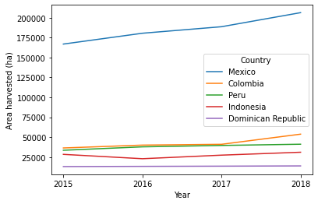
Top 5 avocado producers and ha of land used
Countries with a steady use of land
Peru, Indonesia and Dominican Republic
Countries increasing the land used for production
Mexico and Colombia increased substantially the use of their land to keep growing their production
Notes:
Mexico and Colombia increased substantially the use of their land to keep growing their production.
Even though the Dominican Republic is the second biggest producer, it's the one that uses the less Ha out of the top 5 producers and has had a steady use of the land for the past years.

Slide 11
Conclusions
There's a general increase in production over the past years
Every year more land is being used for avocado production across the world
The biggest avocado producer by far is Mexico
Other top producers have very similar trends of production and land usage
There are some emerging European countries that started to produce their own avocados but their production is still very low

Slide 12
THANK YOU!
I HOPE THIS PRESENTATION DIDN'T MAKE YOU HUNGRY
Any questions?

